Slide 1

DATA ANALYTICS
Customer Shopping Behavior Analysis
Analyzing 3,900 customer transactions to uncover spending patterns, preferences, and strategic opportunities across product categories and customer segments.

Slide 2
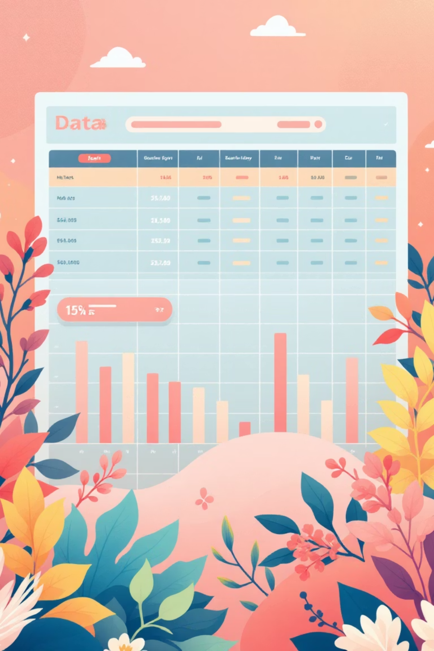
Dataset Overview
3,900
18
50
Total Purchases
Data Features
Locations
Transactions analyzed across all categories
Comprehensive customer and purchase attributes
Geographic diversity in customer base
$59.76
Avg Purchase
Mean transaction value across all customers
Key features include customer demographics, purchase details, shopping behavior metrics, and product information. Only 37 missing values found in Review Rating column.

Slide 3
Data Preparation & Cleaning
01
02
03
Data Loading & Exploration
Missing Data Handling
Feature Engineering
Imported dataset using pandas, examined structure with df.info() and summary statistics
Imputed 37 missing Review Rating values using median rating per product category
Created age_group bins and purchase_frequency_days columns for deeper analysis
04
05
Data Optimization
Database Integration
Standardized columns to snake case, removed redundant promo_code_used field
Connected to PostgreSQL and loaded cleaned data for SQL business analysis

Slide 4
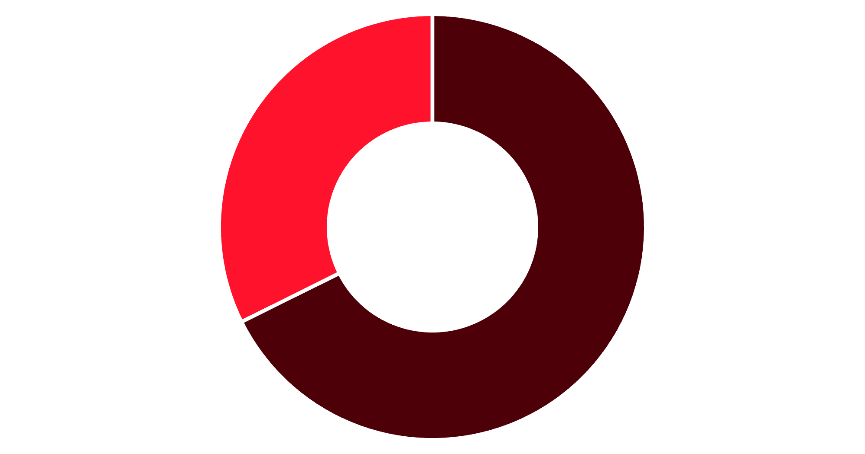
Revenue Insights by Gender
Male Customers Drive Revenue
Male customers generate 68% of total revenue despite representing 68% of the customer base.
This 2:1 revenue ratio suggests male customers may have higher purchase frequency or basket sizes.
Male
Female

Slide 5


Smart Discount Users
839
22%
High-Value Discount Shoppers
Discount Adoption Rate
Customers who used discounts but still spent above average purchase amount
Percentage of total customers using promotional discounts
These savvy shoppers demonstrate that discounts can drive premium purchases. They represent an opportunity to balance promotional strategy with margin protection.

Slide 6




Product Performance Analysis
Top-Rated Products
Discount-Dependent Items
Gloves
50%
3.86 average rating
Hat
Sandals
49.66%
3.84 average rating
Sneakers
Boots
49.07%
3.82 average rating
Coat
Hat
3.80 average rating
48.17%
Sweater
Skirt
3.78 average rating
47.37%
Pants
Express shipping customers spend $2 more on average ($60.48) compared to Standard shipping ($58.46), suggesting premium service attracts higher-value purchases.

Slide 7



Customer Segmentation
Loyal
1
3,116 customers
Returning
2
701 customers
New
3
83 customers
Subscription Impact
Repeat Buyer Behavior
Subscribers: 1,053 customers, $59.49 avg spend, $62,645 total revenue
Among customers with 5+ purchases: 958 are subscribers while 2,518 are not, suggesting untapped subscription potential.
Non-subscribers: 2,847 customers, $59.87 avg spend, $170,436 total revenue

Slide 8
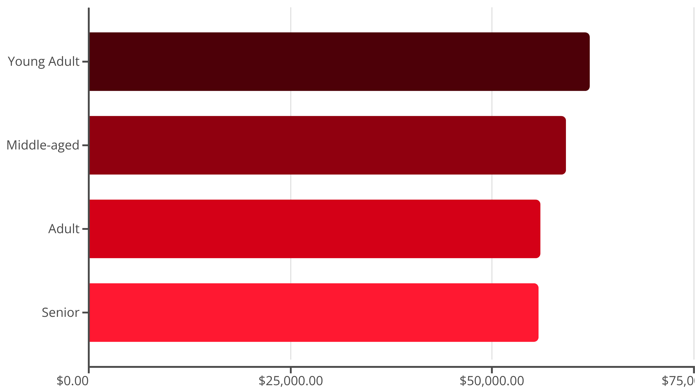
Revenue by Age Demographics
Young Adults lead revenue generation, followed closely by Middle-aged customers. Revenue distribution is relatively balanced across age groups, indicating broad market appeal.

Slide 9
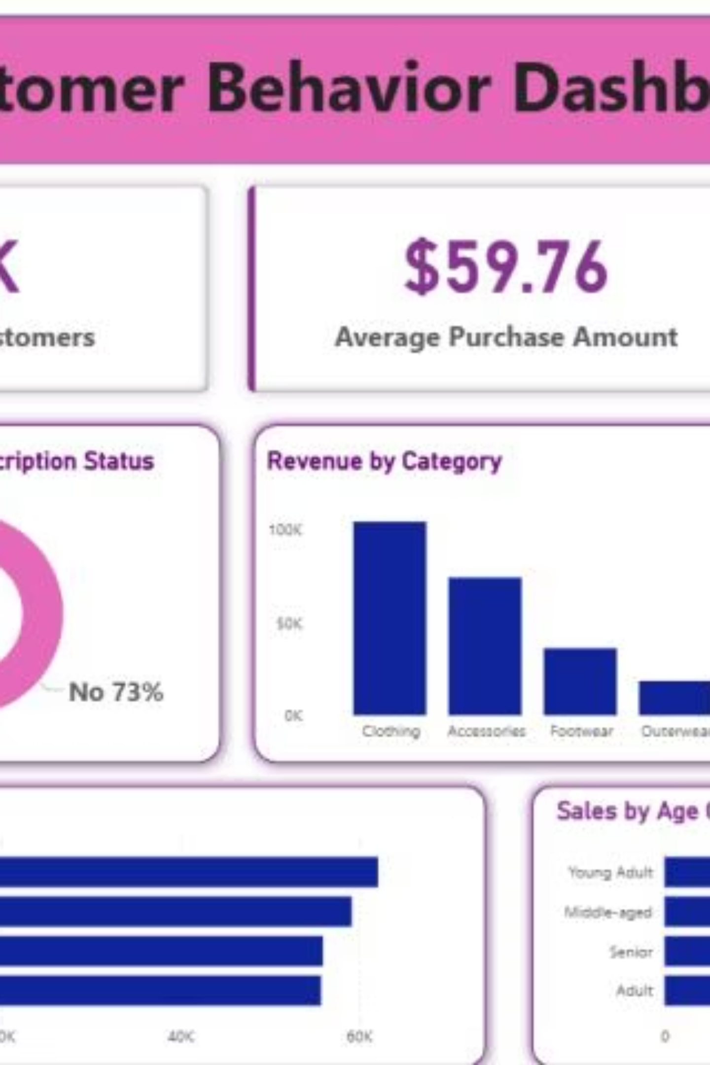
Interactive Dashboard Insights
Subscription Gap
Category Leaders
Only 27% of customers subscribe, representing significant growth opportunity
Clothing dominates both revenue and sales volume across all segments
Consistent Ratings
3.75 average review rating indicates solid customer satisfaction baseline

Slide 10
Strategic Recommendations
Boost Subscriptions
1
Promote exclusive benefits for subscribers to convert the 73% non-subscriber base, especially targeting repeat buyers
Customer Loyalty Programs
2
Reward repeat buyers to accelerate movement from Returning to Loyal segment
Review Discount Policy
3
Balance promotional sales boosts with margin control, especially for discount-dependent products
Product Positioning
4
Highlight top-rated items (Gloves, Sandals, Boots) and best-sellers in marketing campaigns
Targeted Marketing
5
Focus efforts on Young Adult demographic and express-shipping users who demonstrate higher value

